Slide 1


XLR8
Introduction
Connecting Every Citizen to the Right Government Scheme – Instinctively, Instantly
Problem Statement :- Bridge between citizen and government schemes
Theme :- Civic Technology & Governance
Team Name :- XLR8
Team ID :- HSC|AR|288863245
Institution :- North Eastern Regional Institute of Science and Technology
State :- Arunachal Pradesh
Empowering every citizen with clarity, access and confidence.
2

Slide 2
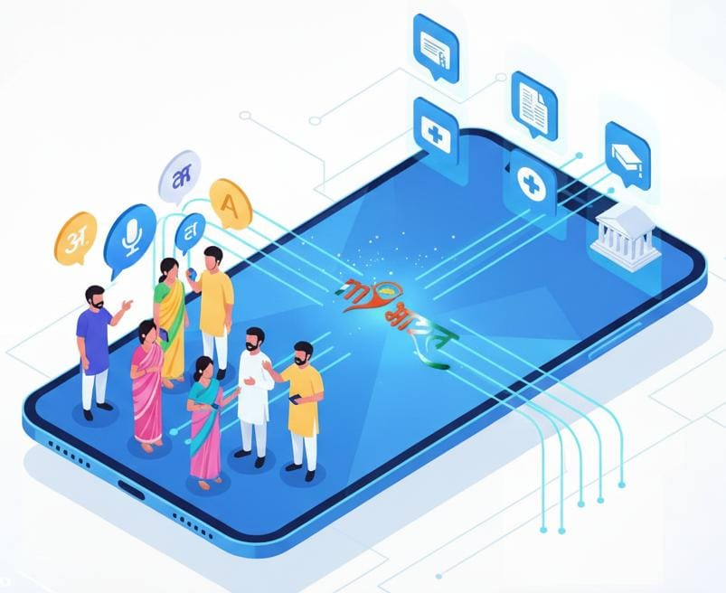
XLR8
Problem Statement
Core Problem / Proposed Solution
Problem: Citizens can’t easily find or apply for the right government schemes.
Solution: An AI + vernacular voice app that identifies eligible schemes and guides users through the entire application process.
Detailed Explanation of the Solution
AI-powered scheme recommendations based on user profile.
Vernacular voice search for easy access.
Step-by-step assistance for application and tracking.
How It Addresses the Problem
Removes language and digital barriers.
Simplifies discovery and eligibility.
Provides complete guidance, increasing scheme adoption.
Innovation & Uniqueness
AI + voice + governance in one platform.
Personalized recommendations with end-to-end support.
3

Slide 3
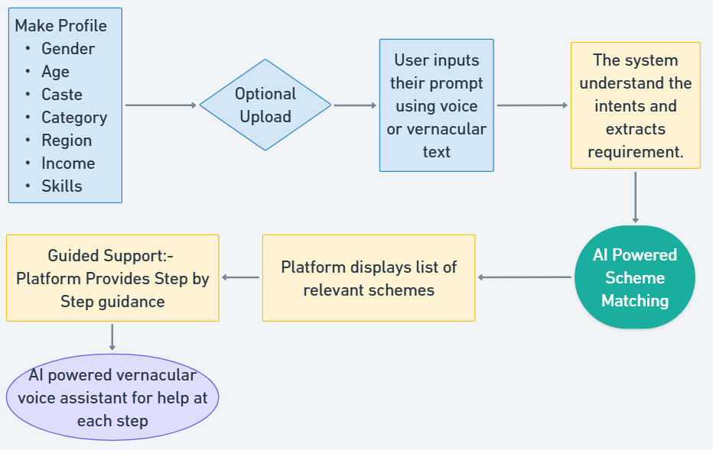
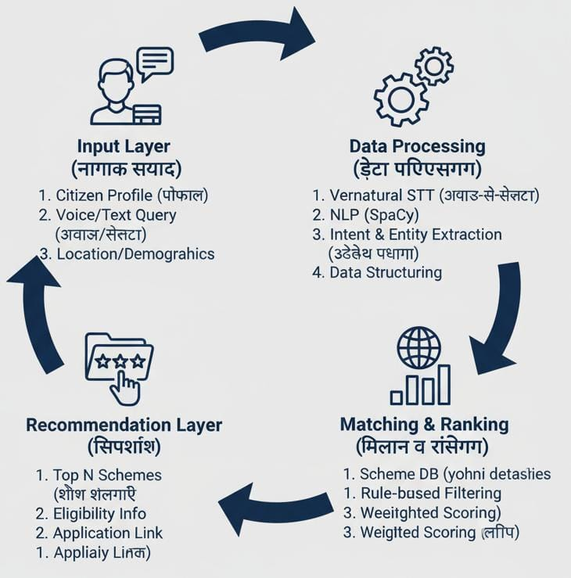
XLR8
FLOW - DIAGRAM
3

Slide 4
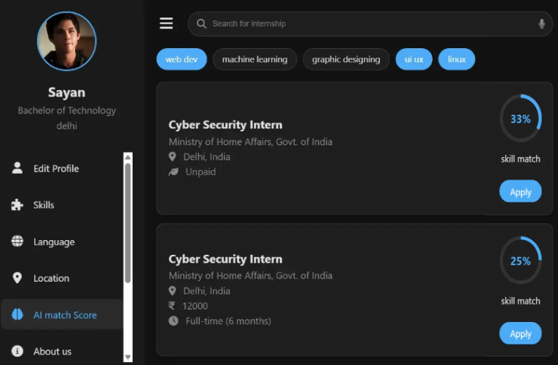
Technical Approach:
System and Model
XLR8
Technology Stack
Frontend(Javascript,html,css) + Backend (Node.js/Python microservice)
AI modules(NLU, ML matching) + PostgreSQL + Cloud infrastructure.
System Workflow
Vernacular Voice – ASR – NLU – personalized scheme recommendations
Guided application(auto-fill, docs)+ real-time tracking & notifications
Development Methodology
Modular microservice architecture with secure REST APIs, CI automation
Monitoring, infra-as-code, and version-controlled development
Deliverables
Prototype: https://xlr8-ai-based-recmd.web.app/
Github: https://github.com/Shyamjyoti-GH/VBYLD_2025
Input => AI processing =>Scheme Matching => Guided Application Support
3

Slide 5
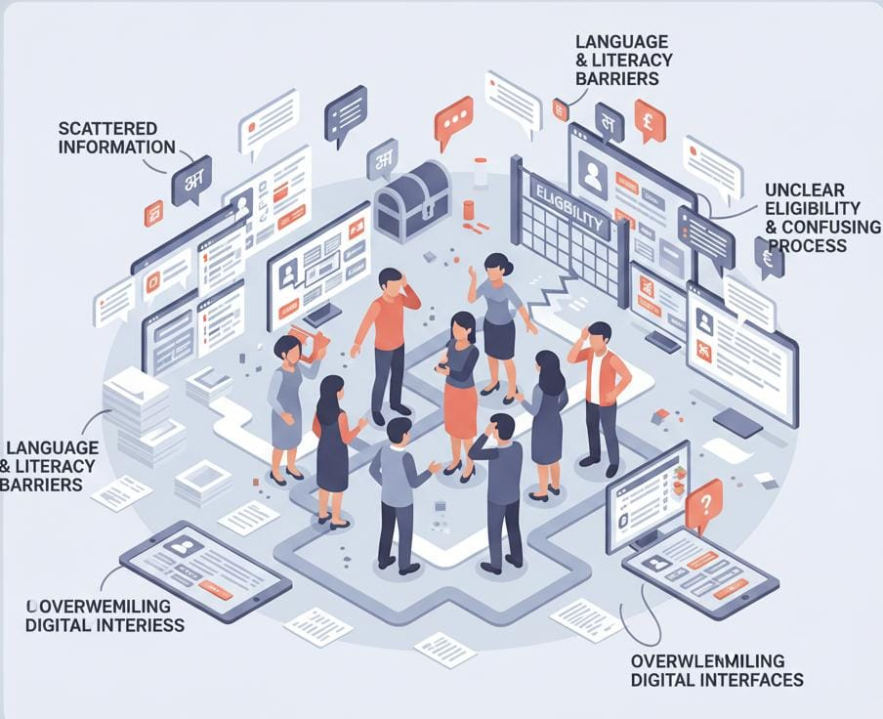
XLR8
Impact Potential
Increases Inclusivity & Reach
Enables citizens across languages and literacy levels to discover and access government schemes easily.
Improves Scheme Efficiency
More accurate, relevant applicants reduce bottlenecks and enhance effective distribution of welfare benefits.
Saves Time & Builds Confidence
Simplifies complex processes, reducing confusion and empowering citizens to apply independently.
Benefits All Stakeholders
Citizens get relevant support, governments gain better implementation, and institutions receive more suitable applicants.
3

Slide 6
XLR8
Feasibility and Risk Analysis
Feasibility:
Cost-effective & lightweight: Uses open-source AI models, minimal infra, CPU-friendly deployment.
Easy integration: Simple APIs allow smooth linkage with backend and government systems.
Key Challenges:
More accurate, relevant applicants reduce bottlenecks and enhance effective distribution of welfare benefits.
Risks:
Data privacy & security: Protecting user data and securing third-party/government API calls
Mitigation Strategies:
Citizens get relevant support, governments gain better implementation, and institutions receive more suitable applicants.
3

Slide 7
XLR8
Team & Reference
Team Composition:
Suman Tripathi/ UI-UX Designer: Designed user flows, wireframes and high-fidelity interfaces
Sanidhya Suman/ Web Dev& Data Analyst: Worked on Govt. scheme Research, AI workflow mapping and Data Structuring
Shyamjyoti Sarkar/ ML , Web Developer: Built Functional Screens, interactions and integrated UI with workflow
Challenges:
Aligning complex scheme data into a unified structure.
Ensuring accuracy and inclusivity across multiple languages.
Team Journey:
Collaborated across roles to merge AI, design and Engineering.
Rapid prototyping, frequent iteration and strong teamwork shaped the solution.
Open Government Data Platform India (OGD)- https://data.gov.in
MyScheme –for browsing, filtering, and checking eligibility https://www.myscheme.gov.in
Google Research – Speech & Language Team Research on speech-to-text, multilingual NLP, and voice-based interaction models relevant to vernacular voice search. https://research.google/teams/language
Whimsical – Flowchart & Diagram Tool for the project. https://whimsical.com
LLaMA 3.1 – Large Language Model Reference architecture for the AI/LLM component used in scheme matching and Q&A. https://ai.meta.com/llama
Thankyou
3

